Slide 1
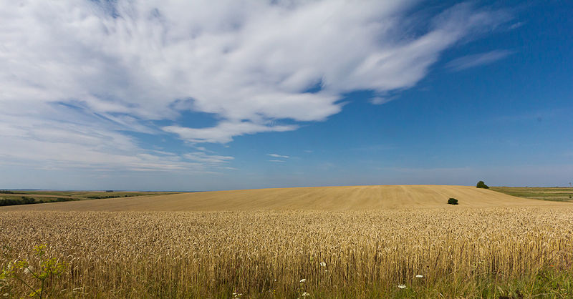
Living with a Sense of Urgency in light of Eternity

Slide 2
Those who live with a sense of urgency:
1. Are armed with the right attitude toward sin and God’s will.

Slide 3
Romans 12:2
Do not conform any longer to the pattern of this world, but be transformed by the renewing of your mind. Then you will be able to test and approve what God’s will is – his good, pleasing and perfect will.

Slide 4
Those who live with a sense of urgency:
1. Are armed with the right attitude toward sin and God’s will.

Slide 5
2. Have abandoned a destructive life style.

Slide 6
3. Are aware of a final judgment.

Slide 7
Romans 14:10-12
You, then, why do you judge your brother? Or why do you look down on your brother? For we will all stand before God’s judgment seat. It is written: “ ‘ As surely as I live’, says the Lord, ‘every knee will bow before me; every tongue will confess to God.’” So, then, each of us will give an account of himself to God.

Slide 8
2 Corinthians 5:9-10
So we make it our goal to please him, whether we are at home in the body or away from it. For we must all appear before the judgment seat of Christ, that each one may receive what is due him for the things done while in the body, whether good or bad.

Slide 9
4. Are alert and prayerful.

Slide 10
Are you living with a sense of urgency in light of eternity?

